Slide 1
Management of Foreign Exchange Exposures

Slide 2
Learning Objectives
Distinguish between the three major foreign exchange exposures experienced by MNCs:
Transaction exposure
Operating exposure
Translation exposure
Examine how each foreign exchange exposure arises in a MNC.
Analyze how to measure foreign exchange exposure.
Evaluate various hedging strategies for foreign exchange exposure.
Discuss the pros and cons of hedging foreign exchange transaction exposure.

Slide 3
Foreign Exchange Exposure
Foreign exchange exposure is the potential impact of unanticipated changes in exchange rates on a firm’s settlement of contracts, cash flow, and market value.
An important task of the financial manager is to measure foreign exchange exposure and manage it to maximize the value of the firm.
There are three main types of foreign exchange exposure:
Transaction exposure
Operating exposure
Translation exposure

Slide 4
Transaction exposure measures changes in the domestic currency value of the firms’ contractual cash flows denominated in foreign currencies due to unexpected exchange rate changes.
Operating exposure (economic exposure, competitive exposure, or strategic exposure) measures changes of the firm value in domestic currency (present value of future operating cash flows) due to unexpected changes in exchange rates.
Both transaction exposure and operating exposure exist because of unexpected changes in future cash flows.
The difference is that transaction exposure is concerned with future cash flows already contracted for, while operating exposure focuses on expected (not yet contracted for) future cash flows that might change because a change in exchange rates has altered international competitiveness.
Translation exposure (accounting exposure) is the potential that the firm’s consolidated financial statements will be affected by unexpected changes in exchange rates as it needs to “translate” foreign currency financial statements of foreign subsidiaries into a single reporting currency.

Slide 5
Hedge Foreign Exchange Exposure
Many firms attempt to manage their foreign exchange exposures through hedging.
Hedging is the taking of a position, acquiring either, an asset, or a contract (including a derivative contract) that will rise (fall) in value and offset a fall (rise) in the value of an existing position.
Why hedge?
Reduction of risk in future cash flows reduces the likelihood of financial distress and improves the planning capability of the firm.
Hedging also reduces the gain from favorable movement in exchange rates.
Hedging is not free, whether the benefits can justify the costs (explicit or implicit).
Shareholder are also capable of diversifying foreign exchange risk.

Slide 6
Management of Transaction Exposure

Slide 7
Transaction Exposure
Transaction exposure arises from the settlement of existing financial obligations that are stated in a foreign currency.
Purchasing or selling goods or service when prices and settlement stated in foreign currencies. (accounts receivable and accounts payable)
Borrowing or lending fund when repayment is to be made in a foreign currency.
Acquiring assets or incurring liabilities of any kind denominated in a foreign currency.
The amount of CFs is fixed in foreign currency, thus their values in domestic currency are subject to exchange rate changes.

Slide 8
Transaction Exposure Example
Hedge foreign currency receivables
Suppose that Boeing Corporation exports a landing gear of Boeing 737 to British Airways billed £10 million to be paid in one year. When Boeing receives £10 million in one year, it will convert the pounds into dollars at the spot exchange rate prevail at that time.
The interest rates and exchange rates are:
i$=6.1%
i£=9%
S₀=$1.50/ £
F₁=$1.46/ £

Slide 9
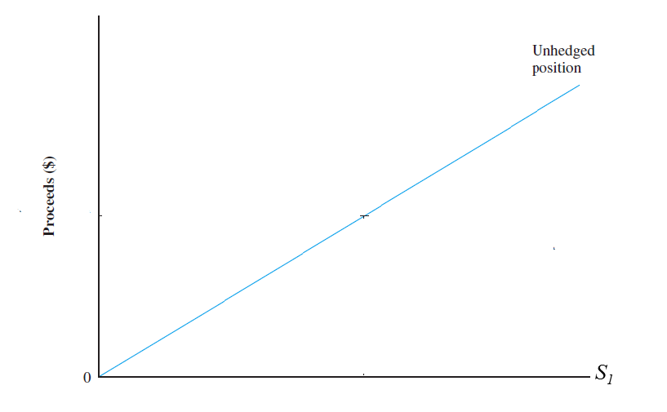
Unhedged
The dollar value of the foreign currency receivable is subject to exchange rate change.
Proceeds at t=1 is £10M*S₁

Slide 10
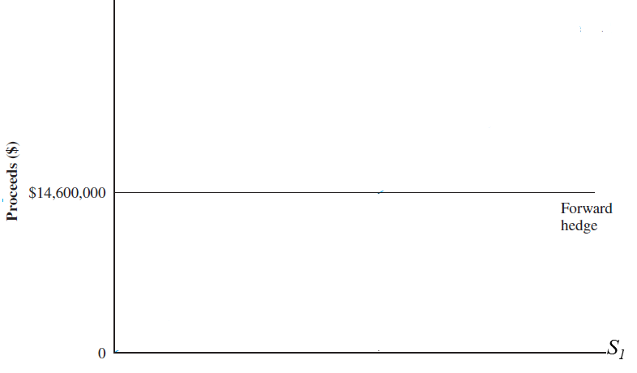
Forward Hedge: sell the foreign currency receivables forward to eliminate its foreign exchange exposure.
At t=0, Boeing takes the short position in the forward contract on £10 million for delivery in one year.
Proceeds at t=1 is £10 M*F₁= £10*$1.46/ £=$14.6M

Slide 11
Money Market Hedge (Balance sheet hedge): Borrow in foreign currency to hedge its foreign currency receivables, thereby matching its assets and liabilities in the same currency.

Slide 12
Currency options allow you to protect downside risk, but still be able to capture upside benefit, for a fee.
Options Market Hedge: buy a foreign currency put option to hedge its foreign currency receivables.
Suppose at t=0, Boeing purchased an OTC put option on £10 M with an exercise price of $1.46 and a one-year expiration. Option premium is $0.02 per pound. Boeing thus paid $0.2M.
At t=1, the dollar proceeds from option is £10M *Max(S_{1,} $1.46/£)
if the spot rate S₁ is higher than exercise price $1.46/£, then Boeing will let the option expire and convert £10M at S₁.
if spot rate S₁ is lower than exercise price $1.46/£, , then Boeing will exercise the option and convert £10M at $1.46/£.

Slide 13
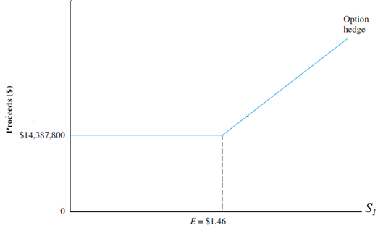
In order to compare with other hedging alternatives, we need to calculated the net dollar proceeds at t=1, which subtract the future value of the option cost paid at t=0.
£10M *Max(S_{1,} $1.46/£)-$0.2M*(1+6.1%)

Slide 14
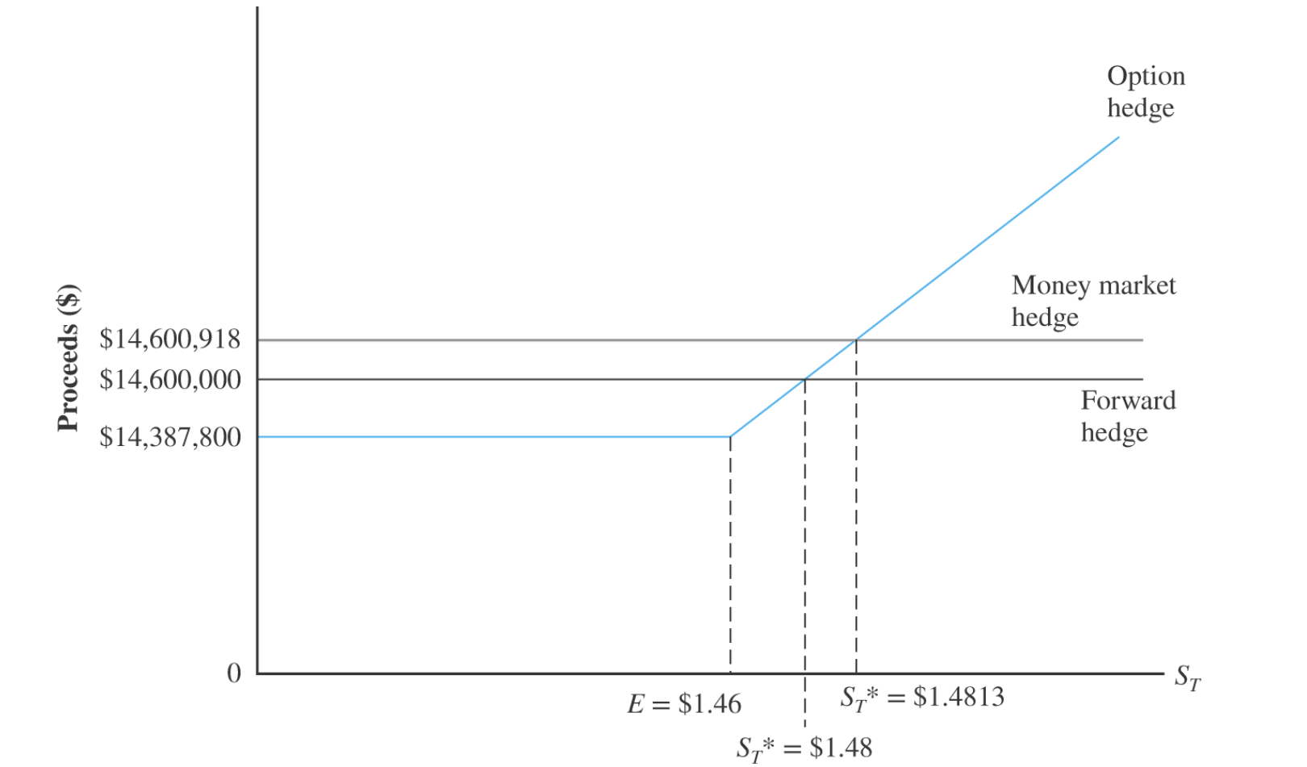
Comparison of alternative hedging strategies
Break-even spot rate (option v.s. forward)
£10M*S₁-$0.2M*(1+6.1%)=$14.6M
S₁*=$1.48/ £
Break-even spot rate (option v.s. money market)
£10M*S₁-$0.2M*(1+6.1%)=$14.600918M
S₁*=$1.4813/ £

Slide 15
Hedge foreign currency payables
Suppose that Boeing Corporation imports jet engine from U.K. and it will pay £5 million in one year.
The interest rates and exchange rates are:
i$=6.0%
i£=6.5%
S₀=$1.80/ £
F₁=$1.75/ £

Slide 16
Unhedged
Payment at t=1 is £5 M*S₁
Forward mkt hedge
Buy £5 M forward
Payment at t=1 is £5 M*F₁ =$8.75M
Money mkt hedge
Borrow $8,450,705 at t=0, convert to £4,694,836 at the spot rate $1.80/ £, deposit at i£=6.5%
Payment at t=1 is $8,450,705 *(1+6%)=$8,957,747
Option mkt hedge
Buy call option on £5 M with exercise price $1.8/£ and premium $0.018 per pound.
Payment at t=1 is £5 M*Min[1.8, S₁]+ £5 M*$0.018/ £*(1+6%)

Slide 17
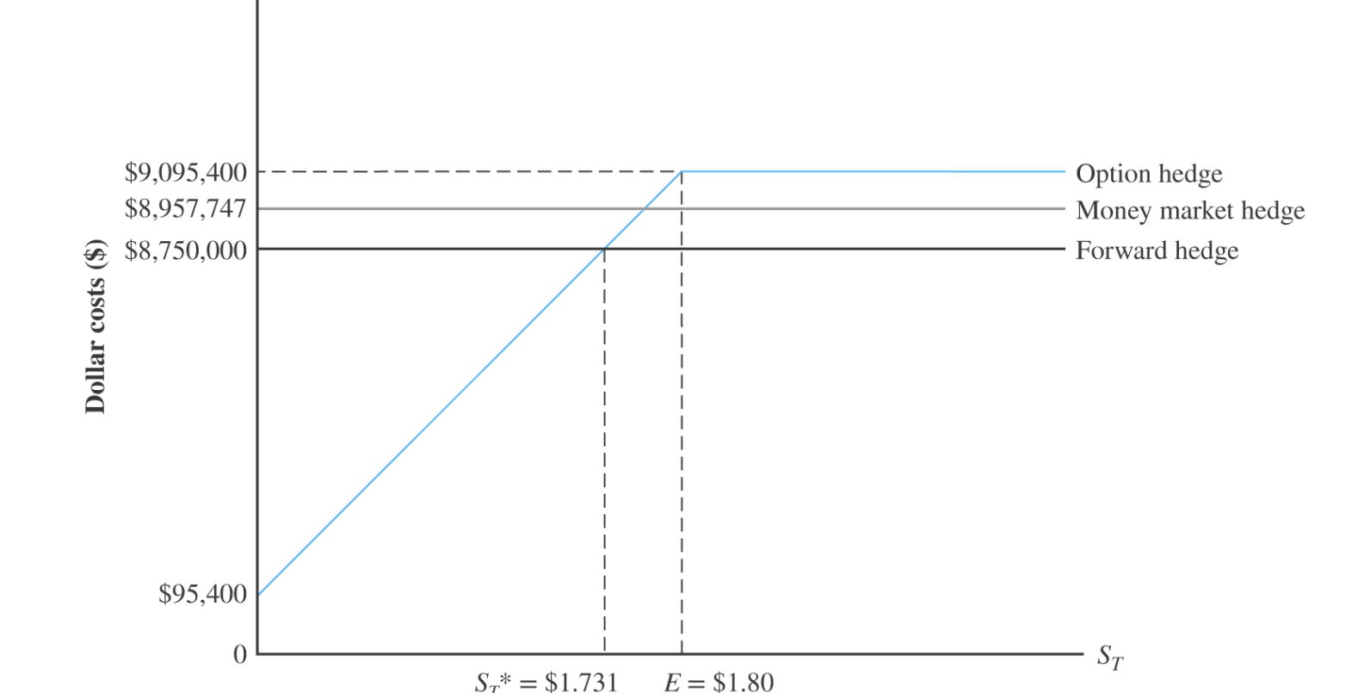
Comparison of alternative hedging strategies
Break-even spot rate (option v.s. forward)
£5M*S₁+$0.09M*(1+6%)=$8.75M
S₁*=$1.731/ £
Break-even spot rate (option v.s. money market)
£5M*S₁+$0.09M*(1+6%)=$8,957,747
S₁*=$1.772/ £

Slide 18
Management of Transaction Exposure
Using financial contracts
Forward Market Hedge
Money Market Hedge
Options Market Hedge
Using operational techniques
Exposure Netting
Lead and lag
Invoice Currency

Slide 19
Exposure Netting
If a firm has both receivables and payables in the same currency, it should consider hedging only its net exposure.
Reinvoice center: a financial subsidiary, that help firm net exposure of intrafirm transactions
E.g. Lufthansa (German airline) will buy $3 billion airplanes from Boeing. It expects to receive $1 billion from airfair sales in US. Lufthansa should only hedge the net exposure of $2 billion.
Hedging via lead and lag
Lead soft currency receivables and lag hard currency receivables
Lead hard currency payables and lag soft currency payables.
Avoid the loss from depreciation of the soft currency and benefit from the appreciation of the hard currency.
E.g. concerned with the likely depreciation of sterling, Boeing would like British Airways to prepay £10 million.
The lead/lag strategy can be more effectively to deal with intrafirm payables and receivables among subsidiaries of the same MNC
Hedging through invoice currency
Shift exchange rate risk by invoicing foreign sales in home currency

Slide 20
Management of Translation Exposure

Slide 21
Translation Exposure
Translation exposure (accounting exposure), arises because financial statements of foreign subsidiaries—which are stated in foreign currency—must be restated in the parent’s reporting currency for the firm to prepare consolidated financial statements.
Translation in principle is simple:
If the same exchange rate were used to translate each and every line item on the individual statement (I/S and B/S), there would be no imbalances resulting from the translation.
However, different exchange rate (historical, current or average) were used for different line items on an individual statement (I/S and B/S) and thus an imbalance would result.

Slide 22
Two basic methods for the translation of foreign subsidiary financial statements are employed worldwide:
The current rate method
The temporal method
Regardless of which method is employed, a translation method must not only designate at what exchange rate individual balance sheet and income statement items are translated, but also designate where any imbalance is to be recorded (current income or an equity reserve account).

Slide 23
Current Rate Method
The current rate method is the most prevalent in the world today.
Assets and liabilities are translated at the current exchange rate .
Income statement items are translated at the average rate for the period.
Dividends are translated at the rate in effect on the date of payment
Common stock and paid-in capital accounts are translated at historical rates.
Gains or losses caused by translation are not included in the calculation of consolidated net income. They are reported separately and accumulated in a separate account (on the B/S) as cumulative translation adjustment (CTA). Thus this method reduces variability of reported earnings.

Slide 24
Temporal Method
Under the temporal method, specific assets are translated at exchange rates consistent with the timing of the item’s creation.
Monetary assets (cash, marketable securities, A/R) and liabilities (CL, LTD) are translated at current exchange rates.
Nonmonetary assets (Inv, FA) and liabilities are translated at historical rates if carried at historical cost. If the value is restated to reflect current value, than use current rate to translate.
Income statement items are translated at the average exchange rate for the period, except for the Depreciation, which are translated at historical rate.
Dividends are translated at the exchange rate on the date of payment.
Equity items are translated at historical rates.
Gains or losses resulting from translation are carried directly to current consolidated income, which increases variability of consolidated earnings.

Slide 25
Current vs Temporal Method Example
Balance Sheet | Local Currency (€) | Current Rate | Current Rate | Temporal | Temporal
Cash | 2100 | CR | 4200 | CR | 4200
Inv (current val=1800) | 1500 | CR | 3000 | CR*CV | 3600
NFA | 3000 | CR | 6000 | HR | 4800
Total Assets | 6600 |  | 13200 |  | 12600
CL | 1200 | CR | 2400 | CR | 2400
LT Debt | 1800 | CR | 3600 | CR | 3600
Common Stock | 2700 | HR | 4320 | HR | 4320
Retained Earnings | 900 |  | 1620 |  | 2280
CTA |  |  | 1260 | N/A | N/A
Total L&E | 6600 |  | 13200 |  | 12600
Income Statement
Sales | 10000 | AR | 18000 | AR | 18000
COGS | 7500 | AR | 13500 | AR | 13500
Depreciation | 1000 | AR | 1800 | HR | 1600
NOI | 1500 |  | 2700 |  | 2900
Tax | 600 |  | 1080 |  | 1160
Profit after tax | 900 |  | 1620 |  | 1740
Foreign Exchange gain (loss) |  | N/A | N/A |  | 540
Net Income | 900 |  | 1620 |  | 2280
Dividend |  |  | 0 |  | 0
Addition to R.E. | 900 |  | 1620 |  | 2280
Historical rate | 1.6
Current rate | 2
Average rate | 1.8

Slide 26
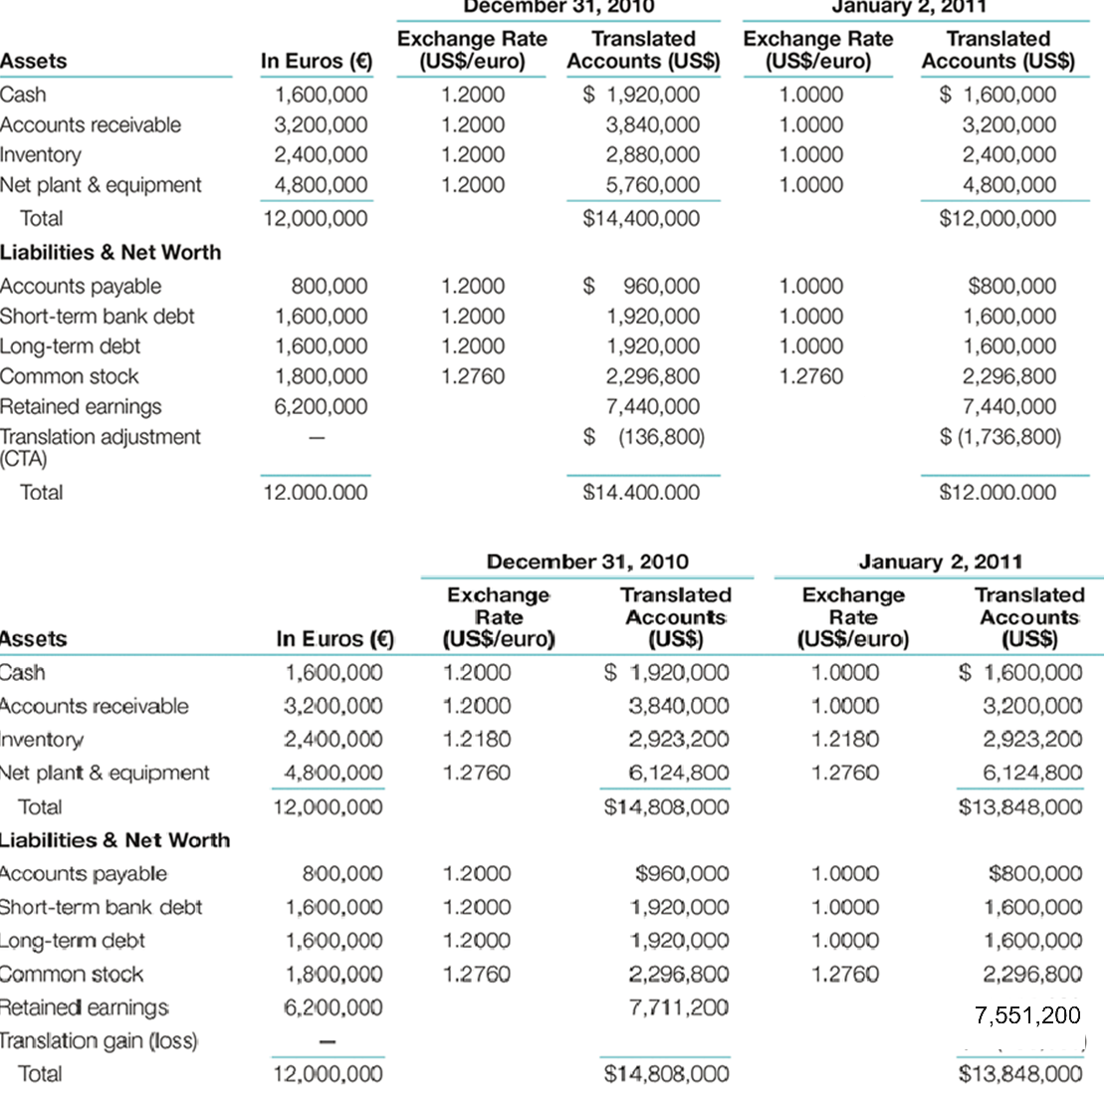
The implied Translation gain(loss) is -160,000

Slide 27
Management of Translation Exposure
The main technique to minimize translation exposure is called a balance sheet hedge.
A balance sheet hedge requires an equal amount of exposed foreign currency assets and liabilities on a firm’s consolidated balance sheet.
If this can be achieved for each foreign currency, net translation exposure will be zero.
Under the temporal method, a zero net exposed position is called monetary balance.
Complete monetary balance cannot be achieved under the current rate method.
The following circumstances could justify when to use a balance sheet hedge:
The foreign subsidiary is about to be liquidated, so that the value of its CTA would be realized.
The firm has debt covenants or bank agreements that state the firm’s debt/equity ratios will be maintained within specific limits.
Management is evaluated on the basis of certain income statement and balance sheet measures that are affected by translation losses or gains.
The foreign subsidiary is operating in a hyperinflationary environment.

Slide 28
Management of Operating Exposure

Slide 29
Operating Exposure
Operating exposure is the extent to which the firm’s operating cash flows would be affected by the unexpected change in the exchange rate.
The effect on operating cash flows arises from the changes on a firm’s competitive positions in domestic and foreign markets, such as price, sales volume, operating costs, which is not readily measurable.

Slide 30
Determinants of operating exposure
The structure of the markets where firm sources its inputs and sells its products.
Firm has high degrees of operating exposure when either its cost or its price is sensitive to exchange rate changes.
Firm has no major operating exposure when both the cost and the price are sensitive or insensitive to exchange rate changes.
Competition from local or oversea competitors
Firm’s ability to mitigate the effect of exchange rate change by adjusting its markets, product mix and sourcing.

Slide 31
Operating Exposure Example
Ganado Germany:
Subsidiary of Ganado U.S.
Material (local and imported) and labor costs are invoiced in euros (€). Sales are 50% domestic and 50% export, both are invoiced in euros(€).
Current exchange rate is $1.2/€.
Projected life is 5 years with no terminal value.
No debt, thus no interest expense.

Slide 32
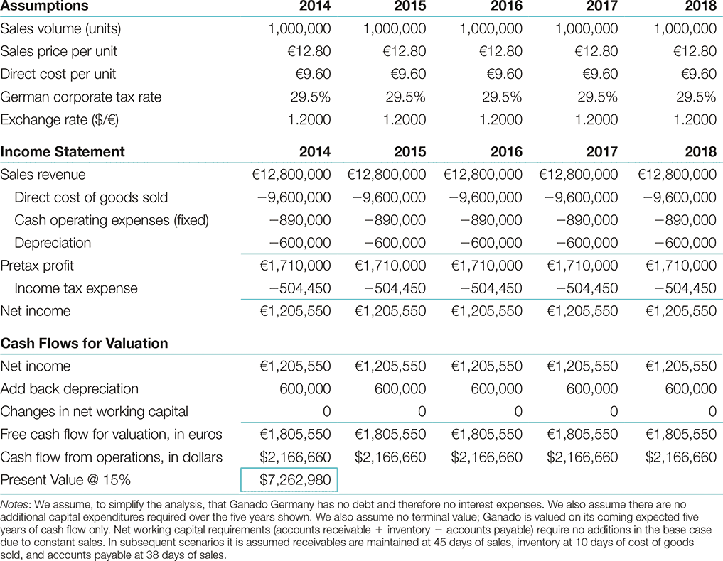

Slide 33
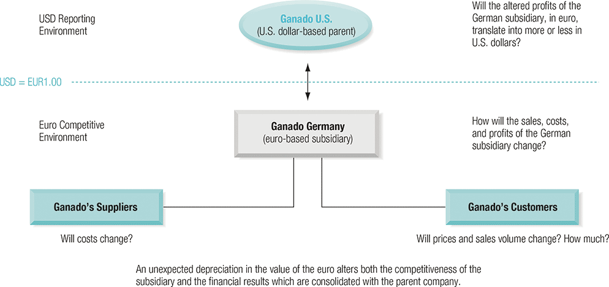

Slide 34
How will the sudden depreciation of euro to $1/€ affect the dollar value of Ganado Germany?
If euro depreciates, the operating exposure for Ganado Germany has two components.
The competitive effect:
Operating cash flow in euro could be affected by altering the firm’s competitive position in the marketplace.
Selling price, sales volume, operating costs.
The conversion effect:
A given operating cash flow in euro will be converted into a lower dollar amount after the euro depreciation.

Slide 35
Potential changes in sales volume, sales price or operating costs.
And for sales volume, the firm may sell more goods domestically and also increase exports as the its gods are more competitive.
Depreciation of euro made the firm’s product competitive with imports, and they are also cheaper in countries whose currencies have not weakened.
About sales prices side, depending on management's opinion about price elasticity of demand and also their assessment of competitor response.
Ganado Germany might choose to maintain its domestic sales prices constant in euro term as management has not observed any change in local operation costs, and they also want to increase market share, or it might try to raise domestic prices as competing imports are now priced higher in euro.
The firm might choose to keep export prices constant in terms of foreign currencies, in terms of euro or somewhere in between.
On the cost side, the firm might raise price because more expensive imported raw materials and components.

Slide 36
Possible operating exposure of Ganado Germany due to unexpected depreciation of Euro
Case 1: Depreciation, no change in any variable
Case 2: Increase in sales volume; other variables remain constant
Case 3: Increase in sales price; other variables remain constant
Maintain the same $ price, pegged to international price level
Case 4: Sales price, cost, and volume increase

Slide 37
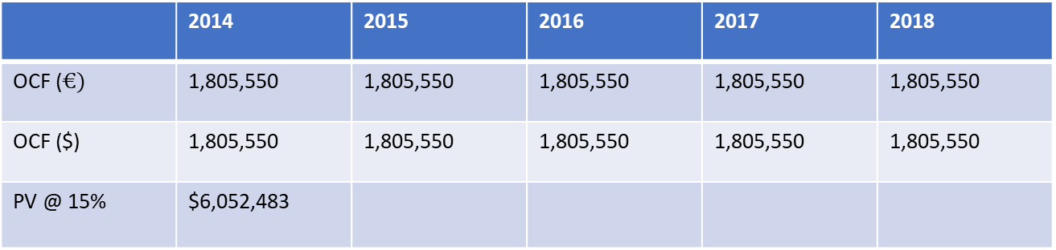
Case 1: Depreciation (1$/€), no change in any variable
 | 2014 | 2015 | 2016 | 2017 | 2018
OCF ($€)$ | 1,805,550 | 1,805,550 | 1,805,550 | 1,805,550 | 1,805,550
OCF ($) | 1,805,550 | 1,805,550 | 1,805,550 | 1,805,550 | 1,805,550
PV @ 15% | $6,052,483

Slide 38
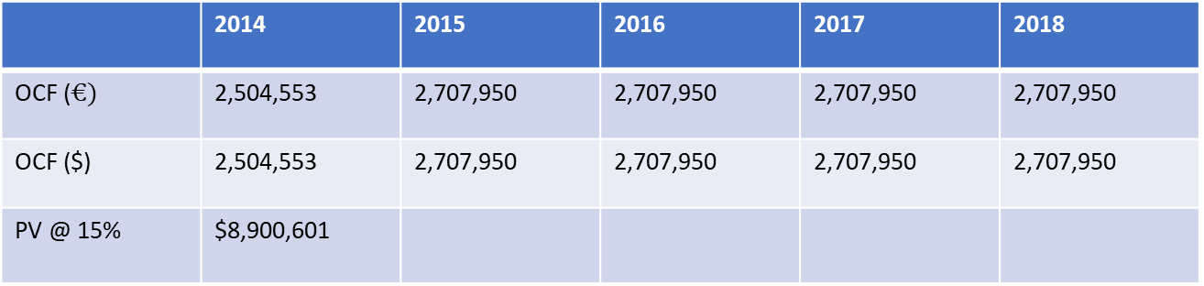
Case 2: Increase in sales volume; other variables remain constant
Assume the sales increase by 40%, i.e. 1,400,000 unit
Sales increased by €5,120,000, NI increased by € 902,400
There is a one-time increase in NWC of € 203,397
 | 2014 | 2015 | 2016 | 2017 | 2018
OCF ($€)$ | 2,504,553 | 2,707,950 | 2,707,950 | 2,707,950 | 2,707,950
OCF ($) | 2,504,553 | 2,707,950 | 2,707,950 | 2,707,950 | 2,707,950
PV @ 15% | $8,900,601

Slide 39
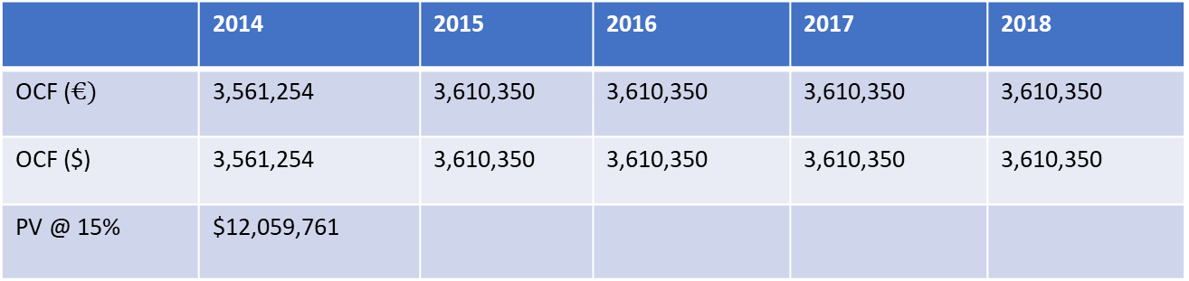
Case 3: Increase in sales price; other variables remain constant
Price increase to €15.36 , which maintain the same $ price
NI increases to € 3,010,350
One time increase in NWC is € 49,096
 | 2014 | 2015 | 2016 | 2017 | 2018
OCF ($€)$ | 3,561,254 | 3,610,350 | 3,610,350 | 3,610,350 | 3,610,350
OCF ($) | 3,561,254 | 3,610,350 | 3,610,350 | 3,610,350 | 3,610,350
PV @ 15% | $12,059,761

Slide 40
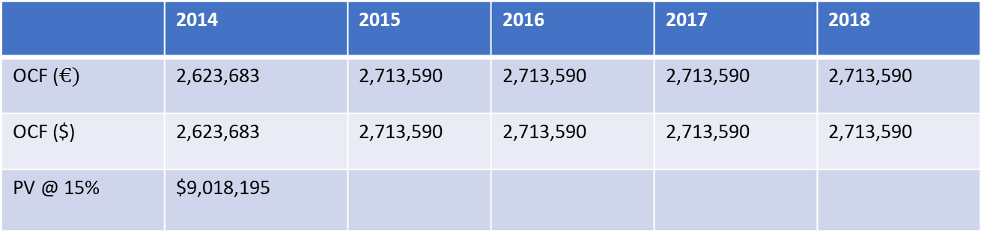
Case 4: Sales price, cost, and volume increase
Price increase by 10% to €14.08
cost increase by 5% to €10
Volume increase by 10% to 1,100,000 unit
NI increase to €2,113,590
One time increase in NWC of € 89,907
 | 2014 | 2015 | 2016 | 2017 | 2018
OCF ($€)$ | 2,623,683 | 2,713,590 | 2,713,590 | 2,713,590 | 2,713,590
OCF ($) | 2,623,683 | 2,713,590 | 2,713,590 | 2,713,590 | 2,713,590
PV @ 15% | $9,018,195

Slide 41
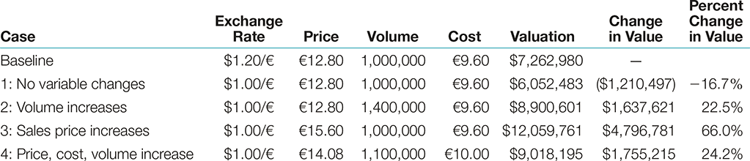

Slide 42
Management of operating exposure
Diversifying operations
R&D and Product Differentiation
less elastic demand
Financial Hedging
Matching currency cash flows (operating cash flows with financing cash flows)

